Slide 1
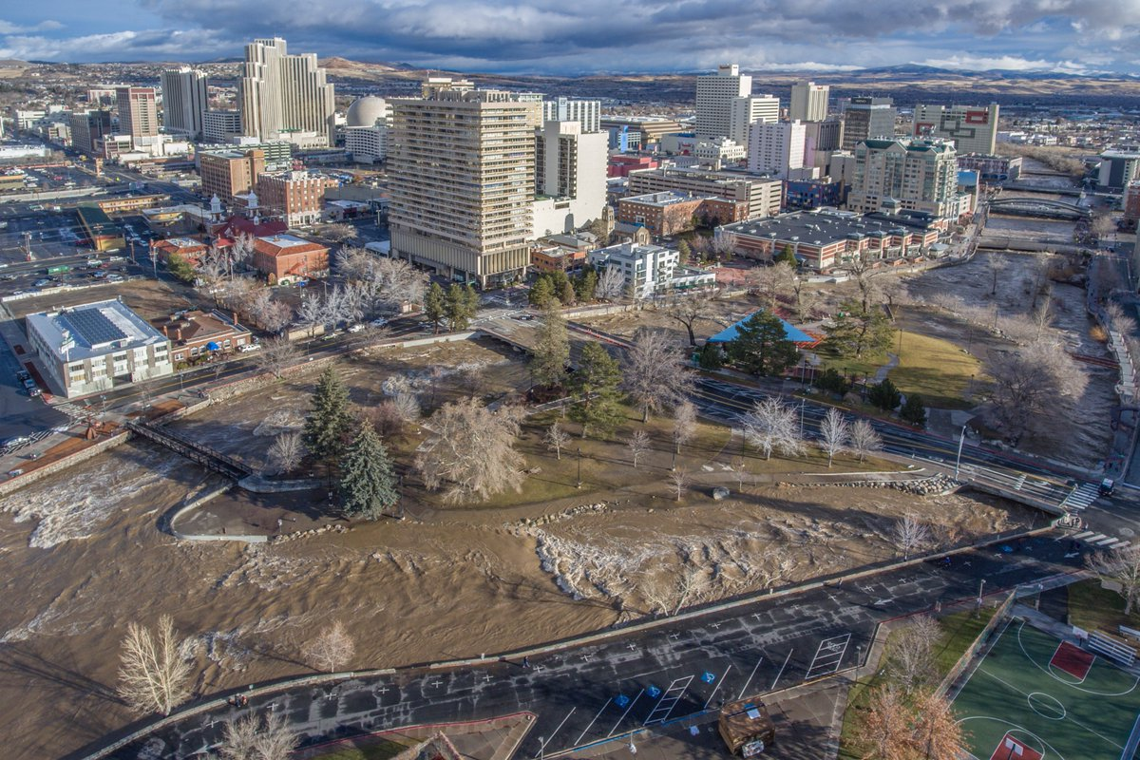
Northern Nevada Winter Storm Event 2017
Nevada Department of Public Safety’s Division of Emergency Management
Incident Location: Northern Nevada and Tribal Nations
Incident Mission #:01042017-151
Incident Overview

Slide 2
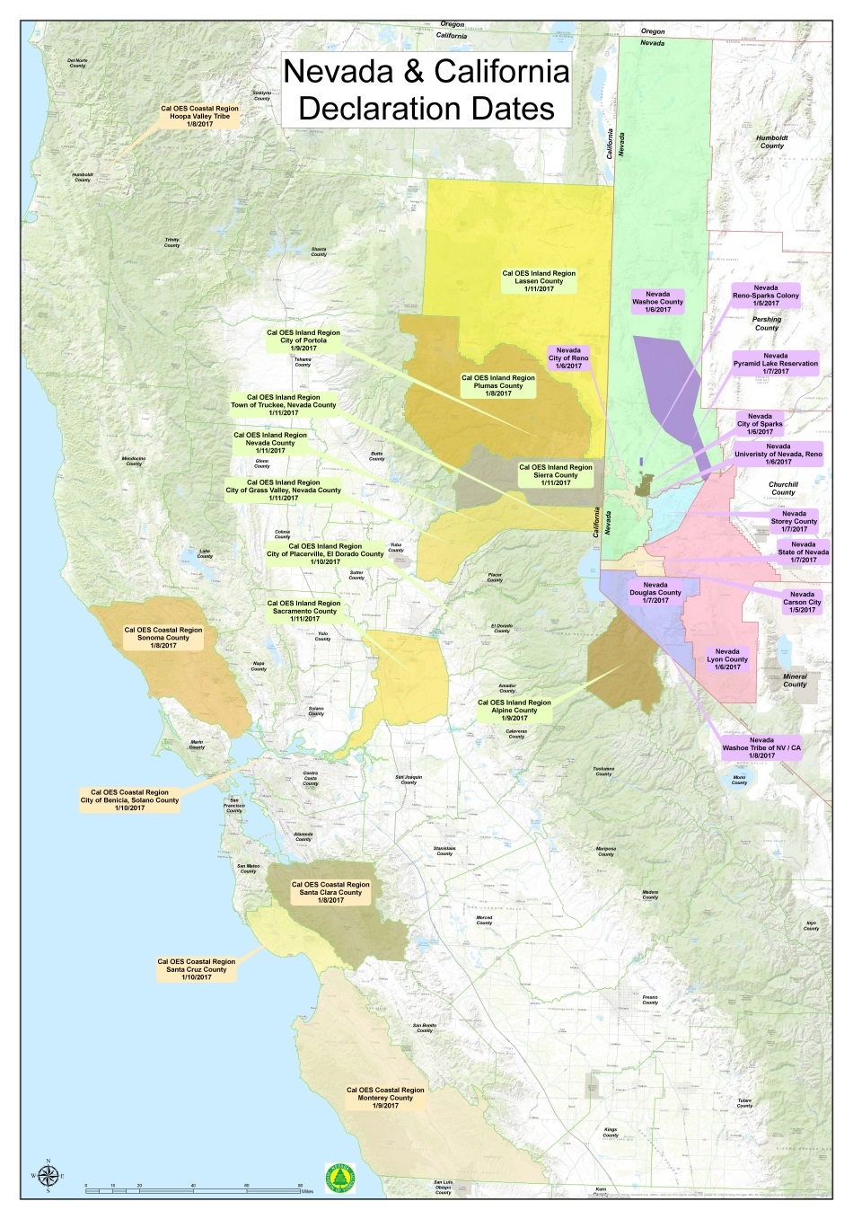
Northern Nevada Winter Storm Event 2017
Incident Overview
The National Weather Service advised local, state and federal partners of a series of atmospheric river storms coming to the northern Nevada area January 4 through January 10. In preparation of the anticipated storms several counties and Tribal nations declared a state of emergency.
A joint State of Emergency was declared including: Washoe, Reno, Sparks, University of Nevada Reno, Carson City, Storey, Douglas, Lyon, Churchill, Reno Sparks Indian Colony, Pyramid Lake Paiute Tribe, Washoe Tribe of California and Nevada and the Fallon Paiute Shoshone Tribe.

Slide 3
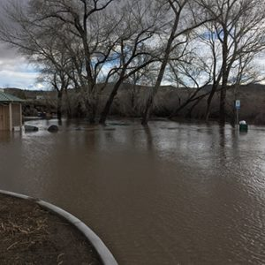
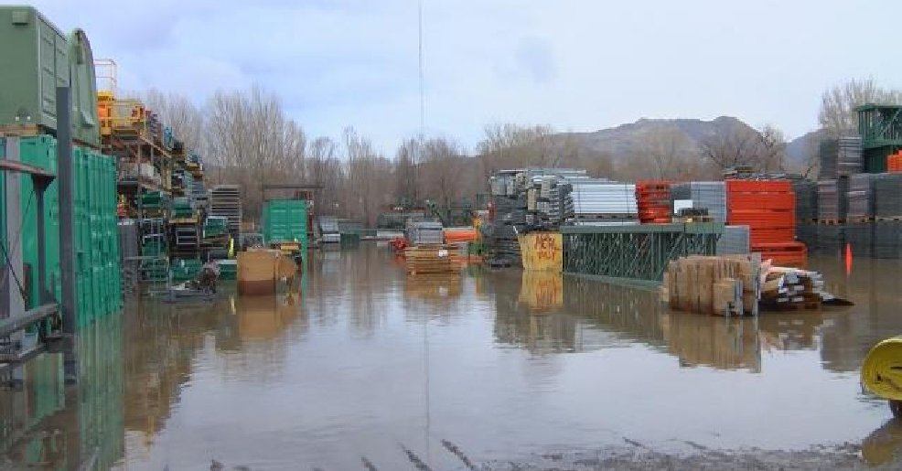
Northern Nevada Flood Event 2017
Incident Overview
Preparation measures were taken to include: sandbagging locations, debris removal, critical alert and public messaging, shelters identified, livestock and pet safety precautions and staffing and resource needs.
Anticipated storms brought disaster levels of mountain snow and heavy rain to the northern Nevada area causing major flooding to area streams and rivers throughout northern Nevada.
Local, state, federal and tribal nations activated their emergency operation centers to manage response efforts in their area. State liaison officers were deployed to local EOCs to assist with resource requests and communication efforts.

Slide 4
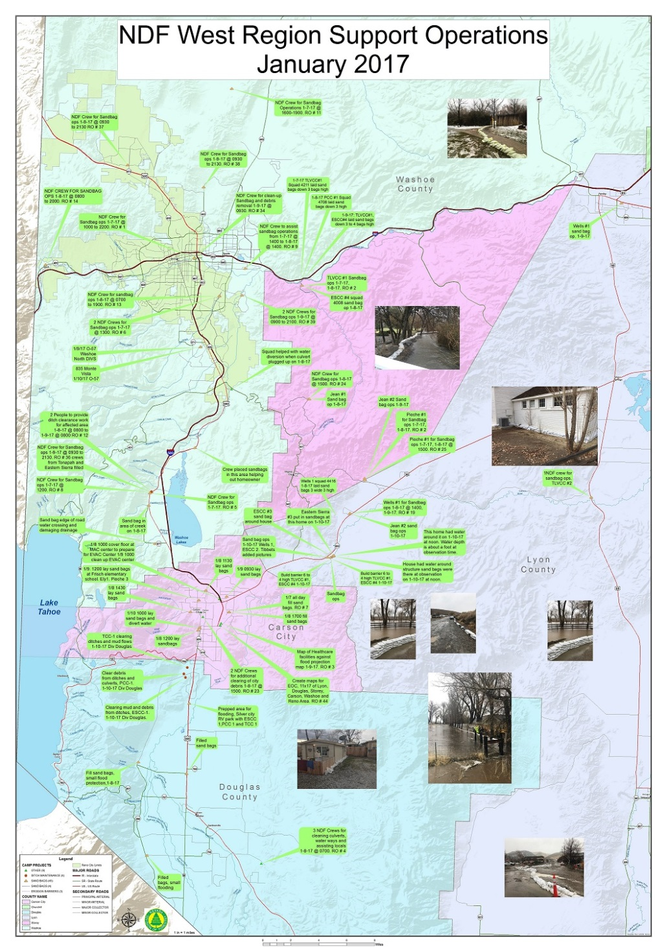
Northern Nevada Winter Storm Event 2017
NDF Hand Crews
The Nevada Division of Forestry (NDF), in conjunction with the Nevada Department of Corrections, operates nine conservation camps throughout the state. The Conservation Camp Program provides training programs to inmates, wildland fire suppression crews, a skilled labor force for conservation projects, community assistance and emergency situations.
On Friday, January 6, 2017 the NDF put together an all hazard incident command structured team to support the anticipated flooding event in the western region of Nevada. The impending flood was predicted to affect multiple counties in Western Nevada. The main objective was to support the Division of Emergency Management by providing assistance to local jurisdictions and Tribal Nations with life safety, critical infrastructure preservation and protection of home and property. In addition the crews helped with evacuation efforts and cleanup of impacted areas.
The NDF team has been working closely with DEM and federal personnel to meet the needs and requests for resources from the affected counties in a timely, safe and effective manner. There are currently a total of 18 supervised NDF hand crews each comprised of 24 inmates. Total personnel assigned - 555

Slide 5
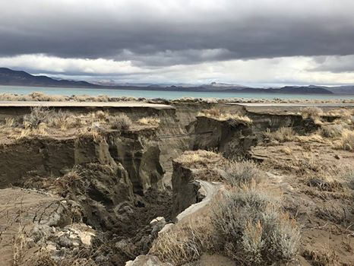
Northern Nevada Winter Storm Event 2017
Road Closures Throughout Event
SR 207 (Kingsbury) from Tramway to Foothill due to sinkhole. Four rock slides over the near the area of the sink hole.
SR446 (Sutcliffe Highway) closed indefinitely due to road washed out.
SR447 Shoulder drop off, building up shoulder, 10% debris removal.
SR342 at Silver City is closed indefinitely. One lane available to Emergency vehicles and local residents only. `.
I-80 in Nevada. Stateline to Keystone, Major issues with asphalt pavement blowouts (potholes). There is also a bridge deck damage.
US050A Hazen to Fernley, shoulder damage isolated locations entire routes.
SR659 (Manzanita and Greensboro WB single lane for traffic. Debris, pavement and shoulder repair

Slide 6
Northern Nevada Winter Storm Event 2017
Highways Damaged
Routes | Damages
I580 | Exit 61 NB/SB Off; Flooding
I80 | PE County, MP 31.1; Shoulder saturation and slope repair
SR206 (Genoa Ln) | MP 12.7-13.8, mainly SB; Shoulders washed out
SR206 (Genoa Ln) | MP 10.0-10.3; cutbacks washed down and around Walleys Hot Springs
SR207 (Kingsbury) | MP 11.0-11.6, mainly SB; Shoulder washed out
SR207 (Kingsbury) | Tramway to Foothill; Roadway failure
SR2671 (Holcomb) | Whole route; Flooding, possible washout
SR341 (Geiger) | ST County MP 0-1.57 NB; Shoulder washed out
SR341 (Geiger) | ST County MP 7.53-10.76; Shoulder washed out
SR341 (Geiger) | MP 16-16.5; Shoulder damage
SR342 | LY County MP 0-0.3 NB; Shoulder washed out and guardrails exposed
SR439 (USA Pkwy) | Denmark to Electric; Flooding
SR445 (Pyramid Way) | MP 10-44; Extensive damage in various locations, erosion, washouts, pavement damage
SR446 (Sutcliffe Hwy) | MP 3.0; Culvert completely washed out with complete road and culvert rebuild
SR446 (Sutcliffe Hwy) | MP 7.2; Extensive shoulder and culvert damage with serious erosion
SR446 (Sutcliffe Hwy) | MP 9.0; Extensive culvert damage and washout culvert damage, shoulder damage
SR447 | WA County MP 13; Extensive shoulder damage with some erosion under pavement shoulder
SR887 (Franktown Rd) | Ditch, shoulders, damage from flooding
SR447 | WA County MP 33; Extensive shoulder damage with some erosion under pavement shoulder
SR647 (W. 4th St) | 9400 Block; Rock & mudslide
SR659 (McCarran) | MP 10.6-22.9 various locations; Erosion damage
SR667 SB (Kietzke) | Kuenzli to Galletti; Potential scour
SR757 (Muller) | MP 1.2-2.0 WB; Shoulders washed out
US395 | MP 26.3-31.1; Pothole damage
US395A | S. Meadows to Patriot; Flooding
US395A | Eastlake to Mt. Rose; Flooding
US50 | Multiple washouts
US50A | LY County MP 12.5-13; Extensive shoulder damage

Slide 7
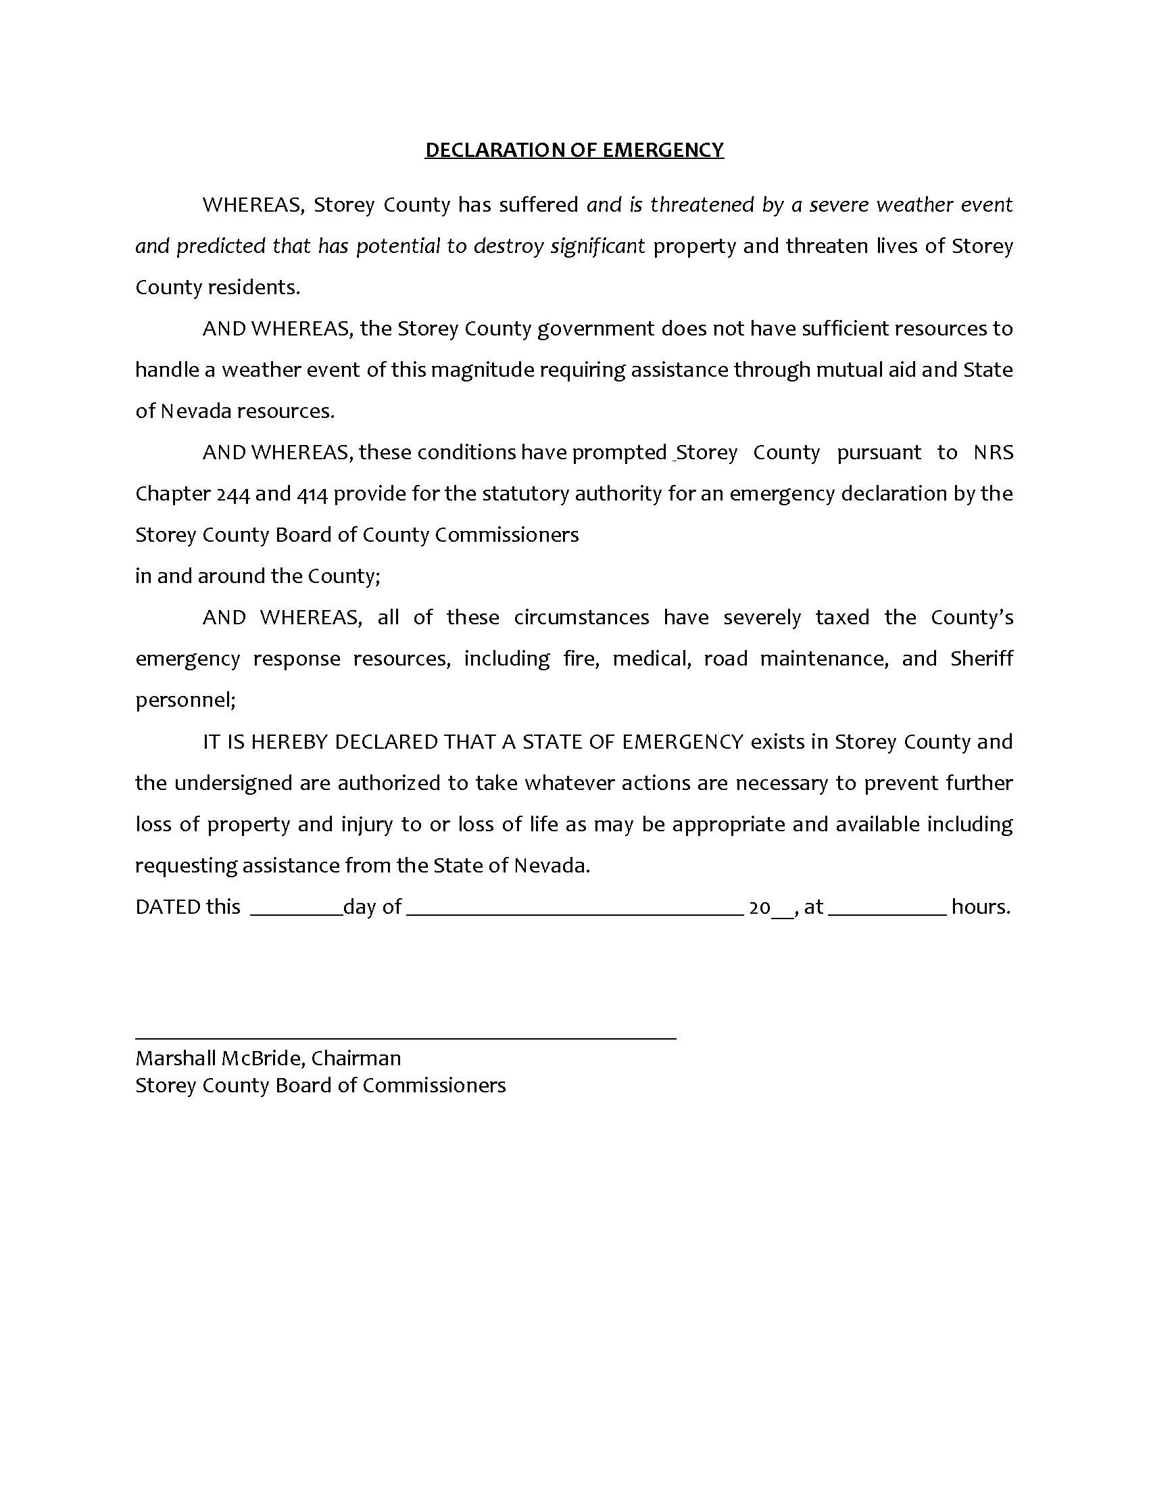
State of Nevada Significant Events
Wednesday, January 4
Division of Emergency Management (DEM) staff meet with the National Weather Service concerning upcoming weather pattern scheduled to hit northwestern Nevada
on Saturday, January 7, 2017
Email notification to the Governor's Finance Office and the Legislative Counsel
Bureau regarding the use of the Emergency Assistance Account.
DEM coordinates efforts with Division of Forestry to prepare hand crews to
monitor the Little Valley Burn Area due to the forecasted weather event.
DEM requested additional NDF hand crews to assist local jurisdictions with sandbag
Filling operations to protect potentially affected homes and critical infrastructure in the
threatened areas.
Local and state agencies coordinate Sandbag locations and potential drainage issues reported
to DEM for assistance and monitoring.
DEM contacted FEMA Region 9 to update leadership on the weather events in northern Nevada
FEMA deploys two liaison officers to Nevada for assistance and situational awareness efforts
Thursday, January 5
DEM compiles situation update report and disseminated to local, state and federal partners
Began hosting the daily Jurisdictional Coordination Calls at 11:00 each day which continue
to this day. All potentially affected jurisdictions were invited to the call; cities, tribal nations,
counties, state agencies and special districts.
Friday, January 6
DEM coordinates preparation efforts for local jurisdictions individual emergency declarations

Slide 8
Historic Snowfall Data

Slide 9
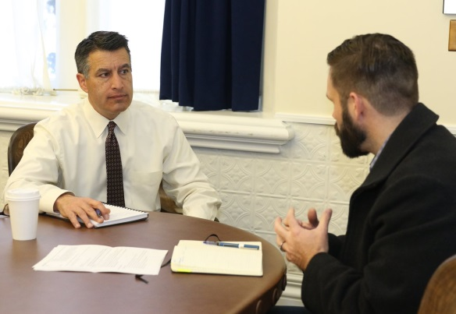
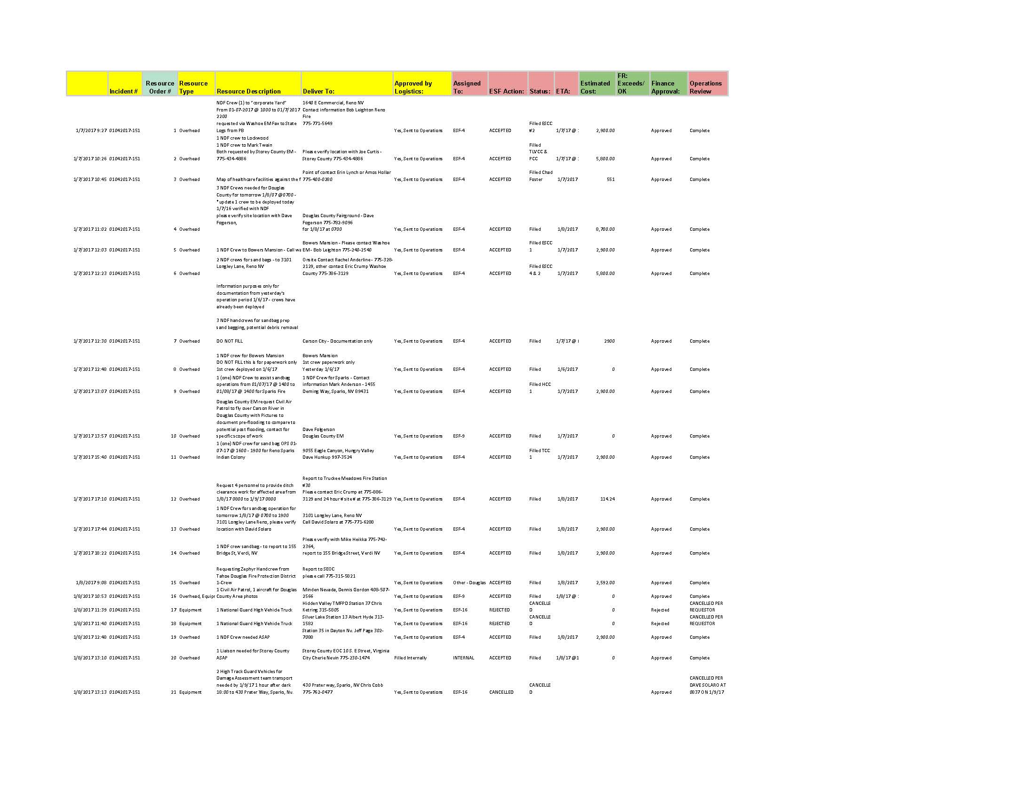
Northern Nevada Winter Storm Event 2017
State of Nevada Significant Events
Friday, January 6
US Army Corps of Engineers contacts are obtained for potential future assistance
American Red Cross region-wide assistance on stand-by
Washoe County Mass Care on stand-by to coordinate evacuation shelters
Monitoring 800Mhz Edac, Ares HF, VHF local area 911 dispatch
Saturday, January 7
State Emergency Operations Center is activated
Governor Sandoval has declared a state of emergency due to the severe weather system
developing in northern Nevada and the consequent danger to life and damage to property. The Governor directed all state agencies to supplement the efforts of Washoe, Douglas, Lyon, and Storey counties, the City of Carson City, the Reno-Sparks Indian Colony, and the Pyramid Lake Paiute Tribes.
Governor ordered all non-essential
state workers in northern Nevada
to stay home on Monday
DEM staff assisted with ordering and
deploying resources to local jurisdictions
And tribal nations. To date 125 resources
were requested for this incident.

Slide 10
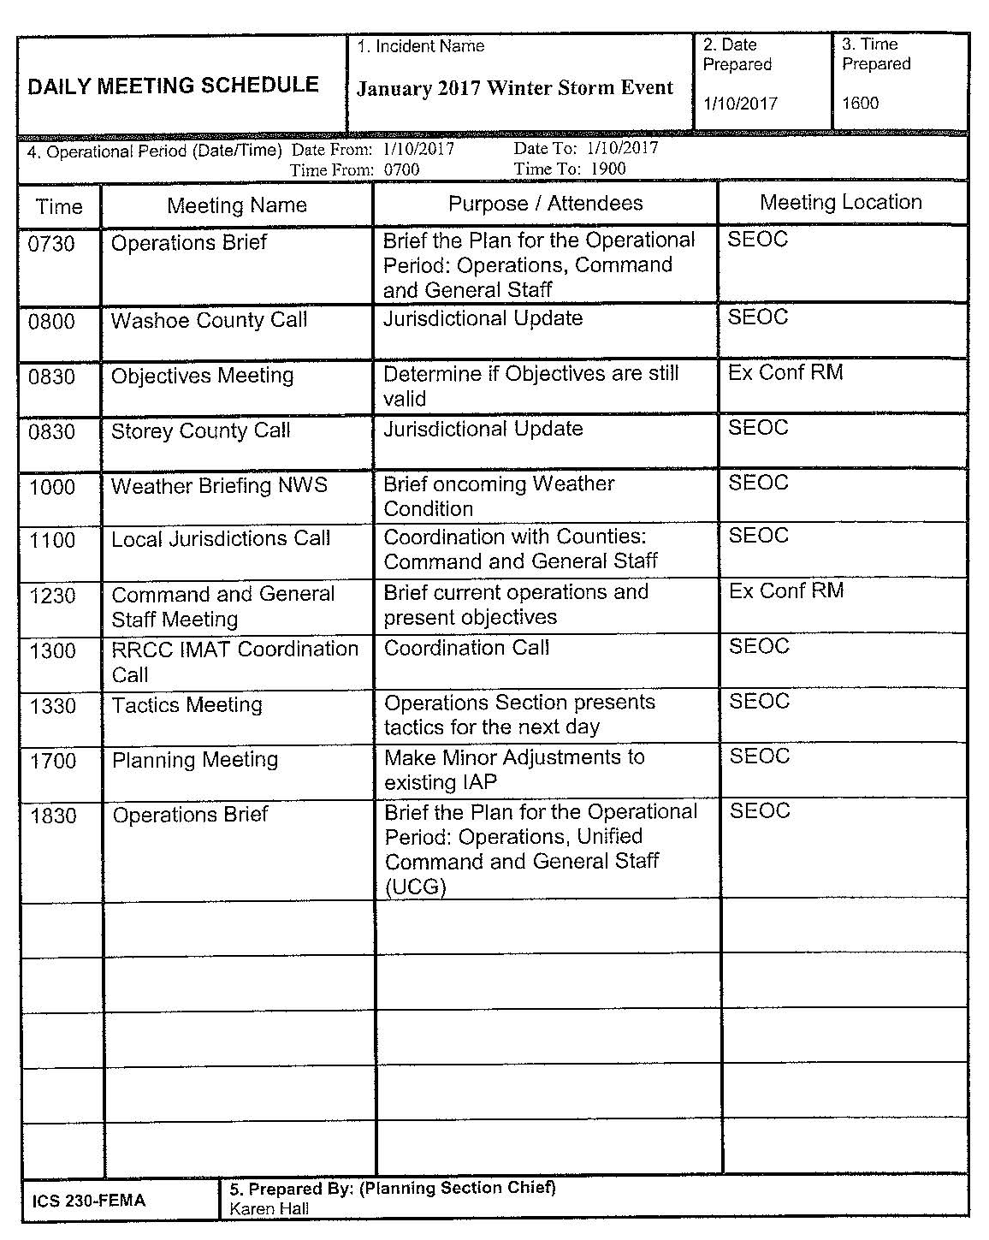
Northern Nevada Winter Storm Event 2017
State of Nevada Significant Events
Sunday, January 8
State Emergency Operations Center increases to full activation
EOC increased to 12 hour operational periods
Emergency Support comprised of state agencies activated
Monday, January 9
FEMA IMAT team deploys to Nevada
Preliminary Assessment teams prepare for deployment
Daily conference calls scheduled for weather briefings, jurisdictional
and Tribal Nations updates
Morning and evening situation reports are prepared and disseminated
Morning and evening incident action plans are prepared and disseminated daily
Daily meetings conducted for Command and general staff
Estimated cost of incident compiled daily
NVNG deployed high water vehicles to assist with potential
evacuations and flood support to Washoe and Storey County
Tuesday, January 10
Assisting local jurisdictions with public outreach, messaging,
social media updates and awareness
Preparing and disseminating press releases
Monitoring rumors and correcting the information
Reposting and disseminating all content to the state’s website,
social media platforms, local JIC, PIOs and statewide partners.

Slide 11
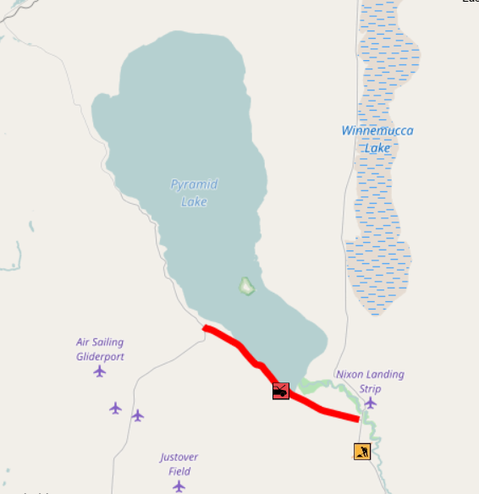
Northern Nevada Winter Storm Event 2017
State of Nevada Significant Events
Wednesday, January 11
Emphasis was placed on providing resources and assistance to vulnerable populations in the Sutcliffe area at Pyramid Lake
SR-446 washed out in both directions between Sutcliffe and Nixon due to flooding
Approximately 650 residents in Sutcliffe without potable water. Water system was damaged and lost pressure due to a break in the main lime. As a precaution residents are urged not to drink the water.
Short term assistance is being provided with long-term measures being
explored by Conservation and Natural Resources, Rural Water Association,
and NDEP.
Pyramid Lake Paiute Tribe (PLPT) at Sutcliffe has restricted access due to
Hwy 446 becoming washed out. DEM Liaison was sent to assist PLPT
The Pyramid Lake Paiute Tribe has closed all recreational activities
at Pyramid Lake until further notice due to hazardous conditions and utility
outages in the area
24 pallets of water were ordered to support local residents and delivered
in phases to accommodate storage.
DEM ordered 1500’ of water pipe to repair the existing waterline damage.
A “Water Buffalo” (a trailered water tank) was delivered by the national guard
for the community until the line is repaired. Once repaired, it took an additional
two days for the community water tank to fill.
The Nevada Department of Conservation and Natural resources (DCNR)
Water System Specialists assisted the tribe in evaluating the repairs of the
System.

Slide 12
Northern Nevada Winter Storm Event 2017
State of Nevada Significant Events
Repeaters on Virginia Peak station went down making radio communications with dispatch unavailable. PLPT unable to tone out volunteer firefighters if needed and Truckee Meadows may also have affected communications.
A satellite health clinic opened to provide assistance to patients needing medical care and medications. Transportation was provided to medical facilities in Reno.
Lyon County supplied a water tender to aid in supplying water to the community – offered two additional to expedite the process. Additionally, two H2O trailers with 5000 gallon capacity each were supplied. NDOT engineers evaluated existing roadways to ensure the loads would be supported on the saturated roadbed. The 2 5k water tanks were tested for use. Washoe County Health District offered two additional trucks to assist Lyon County’s water trucks to allow rapid refill of the water tank for the community.
Washoe County Health District will also be providing 1,000 1oz bottles of bleach for sanitation purposes
NDOT sent a road engineer to assess safety of roads leading to
pump and storage tank. Some roads in the area have been repaired
for better access.
Washoe County RAVEN flew over the affected area to survey
the damage on 1/13/17
Chief Caleb Cage visited PLPT to see damages, speak with tribal
officials, and take part in a community meeting at 6pm 1/14/17.
State PDA teams completed their assessment and advised that with
Sutcliffe they are over the necessary threshold for federal assistance.
They will report back to FEMA and make a request for a joint PDA
team.

Slide 13
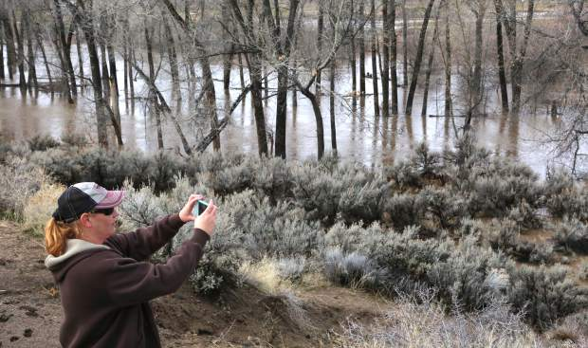
Northern Nevada Winter Storm Event 2017
Carson City Significant Events
Saturday, January 7
Activated Emergency Operations Center
Emergency Declaration was prepared
Sandbagging locations opened in multiple areas of the region
Shelters identified and prepping to open upon request
Sunday, January 8
The Stewart Indian Colony sandbagged problem areas
Established non-emergency flood hotline
Multiple road closures throughout Carson City area
Monday, January 9
Additional road closures
Carson River rose to major flood status and continues to be monitored
Tuesday, January 10
Reactivated their EOC due to flash flooding at 10:30 pm
Wednesday, January 11
Estimated cost reported $214, 023
Friday, January 13
Damage assessments teams deployed
Efforts shifted to recovery phase

Slide 14
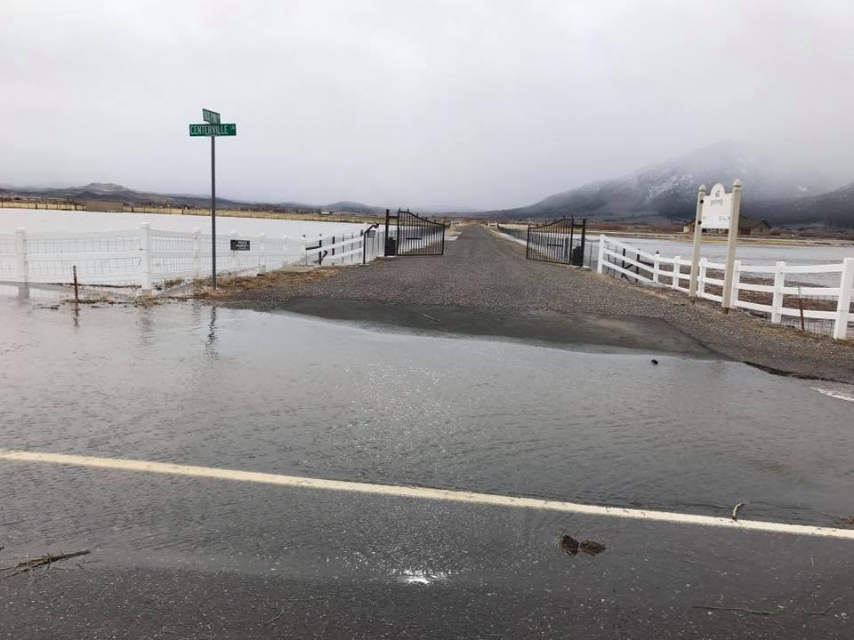
Northern Nevada Winter Storm Event 2017
Douglas County Significant Events
Saturday, January 7
Activated Emergency Operations Center
Emergency Declaration was prepared
Sandbagging locations opened in multiple areas of the region
Shelters identified and prepping to open upon request
Washoe Tribe Dresslerville and Woodfords communities sandbagged problem areas
Sunday, January 8
Small sinkholes developed at the end of street in Indian Hills
Road closed on Nye Drive
Opened evacuation shelters
Monday, January 9
Additional road closures due to flooding
Tuesday, January 10
Shelters closed and remain on stand-by
Beaver dam practically breaks flooding Highway 395
North and southbound lanes closed
Wednesday, January 11
Approximately 200 customers without power since 8:40 AM
Thursday, January 12
State Route 207 closed due to sinkhole
Multiple roads remain closed
Friday, January 13
Estimated cost reported $2,592
Numerous potholes reported
Efforts shifted to recovery phase
Damage assessments teams ordered

Slide 15
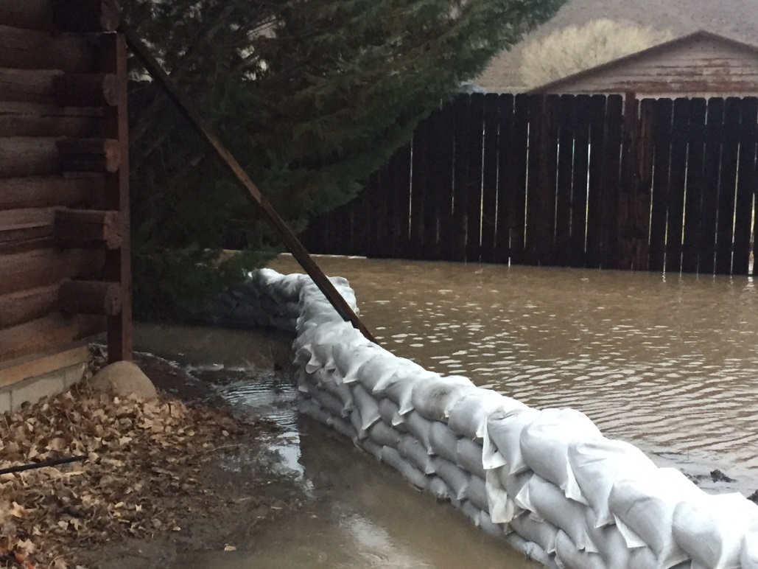
Northern Nevada Winter Storm Event 2017
Lyon County Significant Events
Saturday, January 7
Activated Emergency Operations Center
Emergency Declaration was prepared
Sandbagging locations opened in multiple areas of the region
Shelters identified and prepping to open upon request
Contingency plan developed executed if Dayton Valley Bridge is impacted.
Excavator contracted and staged to remove debris around bridge
Sunday, January 8
Roads closed due to flooding
Tuesday, January 10
Shelters assists 110 residents
Carson River rose to major flood status and closely monitored
Additional roads closed due to flooding
Flooding in the area due to clogged drains
Reverse 911 used to notify the public
Wednesday, January 11
Approximately 20 customers without power since 8:40 AM
Thursday, January 12
Estimated cost reported $69,805
Friday, January 13
Efforts shifted to recovery phase
Damage assessments teams ordered

Slide 16
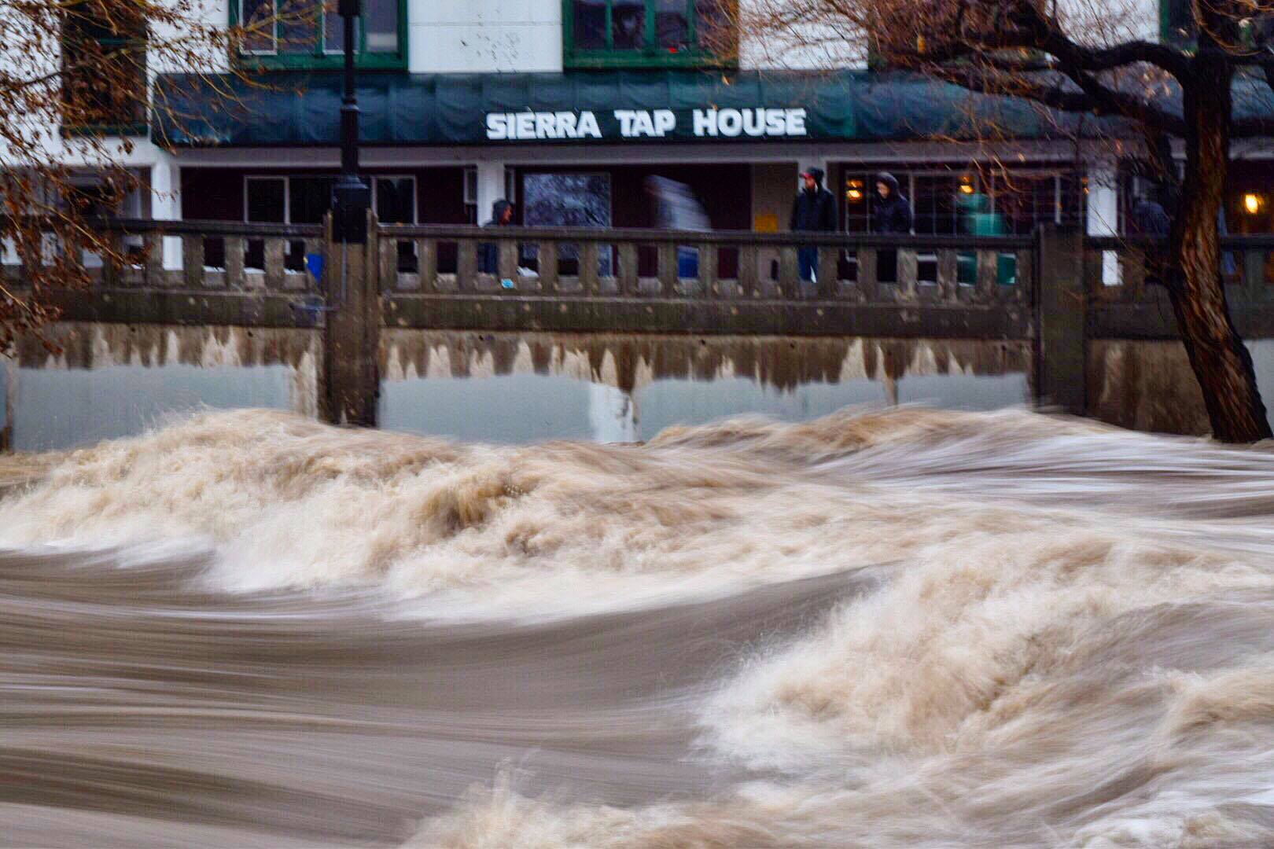
Northern Nevada Winter Storm Event 2017
Washoe County Significant Events
Saturday, January 7
Activated Regional Emergency Operations Center
Cities of Reno, Sparks and Washoe County declared State of Emergency Declaration
Reverse 911 used to inform residents and businesses along the river in the Sparks industrial areas
Monitored rising snow pack for major avalanche risk
Sandbagging locations opened in multiple areas of the region
Shelters identified and prepping to open upon request
McCarran Bridge over the Truckee River closed
McCarran Blvd between I80 and Mill St. closed
Southbound I80 off ramp at Sparks and Vista Blvd closed
Schools and Court houses closed on 1-8-17
Reno/Sparks Indian Colony Health Center sand bagged facility
Livestock at UNR in all agricultural areas were relocated
Wooster High School opened as shelter
Sparks High School opened as shelter
Sunday, January 8
Sierra Avalanche Center has issued extreme danger warning
Mudslide 22 miles north of 395 at Red Rock
Rancho Haven Community is blocked with no power
AM radio stations off the air due to flooding
Avalanche on Mt. Rose Summit with two feet on roadway
Alert disseminated to avoid travel near Back County and Greater Lake Tahoe Region
Monday, January 9
Schools and Court houses in Incline Village closed
Evacuations in Reno and the surrounding areas

Slide 17
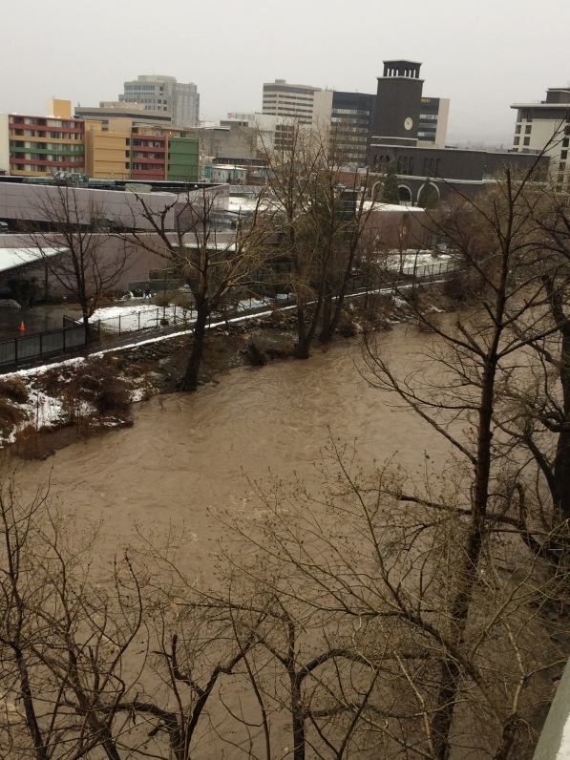
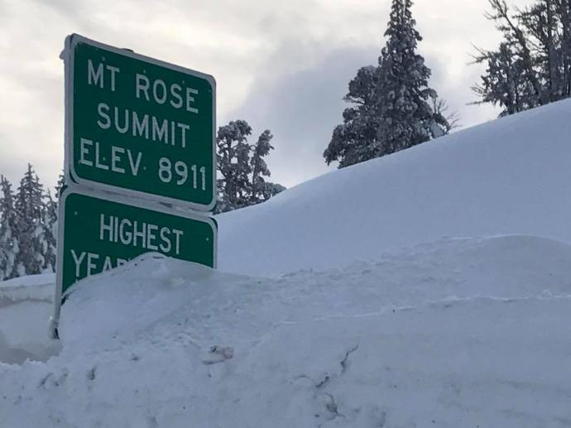
Northern Nevada Winter Storm Event 2017
Washoe County Significant Events
Tuesday, January 10
Shelters close and remain on standby
REOC closed to reopen with regular hours
Multiple roads remain closed due to flood and winter weather events
Sierra Avalanche Center issued high avalanche warning in all elevations
Wednesday, January 11
REOC reopens at 3:00 AM
Approximately 650 customers without water and power in the Sutcliffe area
All schools in Incline Village cancelled through 1-13-17
Residents in the River Belle Mobile Park in Verdi on boil water order
Residents in the Crystal Bay and Incline Village areas advised to shelter in place
Approximately 7,500 residents without power in the Incline Village area.
No cell service in the Crystal Bay area with a weak signal in the Incline Village area.
Pyramid Lake Paiute Tribe at Sutcliffe isolated due to major damage on Highway 446
Pyramid Lake Paiute Tribes closed all fishing and boating activities due to hazardous conditions
Thursday, January 12
Approximately 200 Incline Village residents remain without power
Friday, January 13
Efforts shifted to recovery phase
Mt. Rose State Route 431 opens with chain controls
Washoe County RAVEN completes a fly over Scutcliffe area to access damage
Repeaters on Virginia Peak station are down due to water and ice damage
800 MHZ communications down, dispatch unavailable
Satellite health clinic opened with provide assistance to residents with medical needs
Damage assessments teams deployed

Slide 18
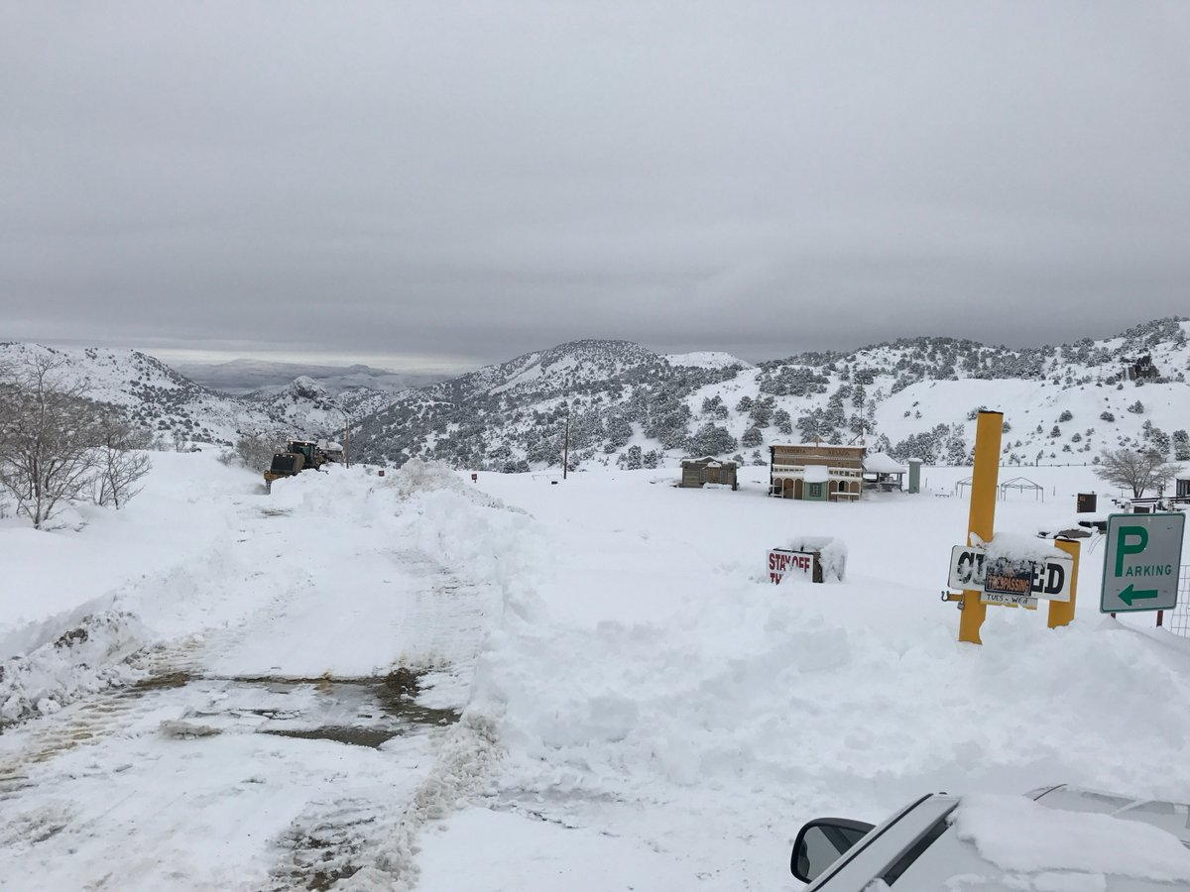
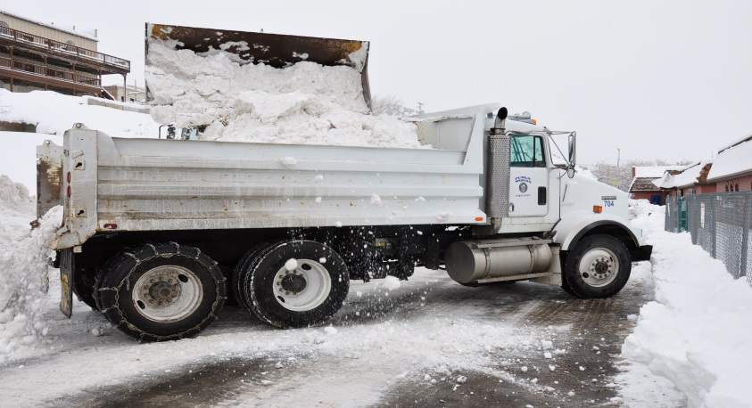
Northern Nevada Winter Storm Event 2017
Storey County Significant Events
Saturday, January 7
Activated Emergency Operations Center
Emergency Declaration was prepared
Sandbagging locations opened in multiple areas of the region
Shelters identified and prepping to open upon request
Sunday, January 8
Multiple roads closed due to flooding
Tuesday, January 10
20 homes in Lockwood without power
Wednesday, January 11
Storey County School District cancelled
Boulder and mudslide on State Route 341
Thursday, January 12
Estimated cost reported $57,316
Residents asked to shelter in place due to snow accumulations
Friday, January 13
Efforts shifted to recovery phase
Damage assessments teams deployed
National Guard delivers four dump trucks for snow removals
Residents in the Highlands area trapped due to snow levels
Life safety and rescue issue with family of five no water, power or food, severe illness

